Slide 1

Malla Reddy College of Engineering and Technology
(Autonomous Institution- UGC, Govt. of India)
Affiliated to JNTUH, Hyderabad
Guide Name: Mrs. B.JYOTHI
Designation: Assistant professor
Team Members:
T.vijeswar Reddy (22N31A66H6)
P.Hussain setty (22N31A66D9)
Y.Rajasekhar Reddy (22N31A66J6)

Slide 2
CONTEXT:
1.ABSTRACT
2.INTRODUCTION
3.EXISTING SYSTEM
4.LIMITATIONS
5.PROPOSED SYSTEM
6.ADVANTAGES
7.REQUIREMENTS
8.Architecture Diagram
9.UML DIAGRAMS
10.REFERENCE
11.CONCLUSION

Slide 3
ABSTRACT:
Crop yield prediction plays a crucial role in modern agriculture, helping farmers, policymakers, and the agro- industry make informed decisions to Crop yield prediction plays a crucial role in modern agriculture, helping farmers, policymakers, and agro- industry make informed decisions to optimize resource allocation, reduce food insecurity, and enhance overall productivity. This abstract provides an overview of the key components and methods employed in data-driven crop yield predictions.
Traditionally, crop yield prediction relied on historical data, expert local climate conditions. However, recent advancements in data collection, machine learning, and remote sensing technologies have opened up new avenues for accurate and efficient predictions.

Slide 4
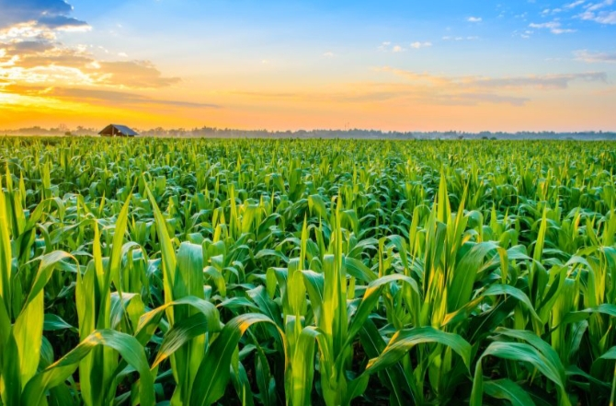
INTRODUCTION:
The main goal of agricultural planning is to achieve maximum yield rate of crops byusinglimited number of land resources. Many machine learning algorithms can help in improvingthe production of crop yield rate. Whenever there is loss in unfavorable conditions. wecanapply crop selecting method and reduce the losses. And it can be used to gain crop yieldratein favorable conditions. This maximizing of yield rate helps in improving countries economy. We have some of the factors that influence the crop yield rate. They are seed quality andcropselection. We need test the quality of the seeds before sowing. As we knowthat goodqualityof seeds helps in getting more yield rate.

Slide 5
EXISTING SYSTEM:
Our farmers should know all the new technologies of machine learning and other new techniques. These techniques help in getting maximum yield of crops. Many techniques of machine learning are applied on agriculture to improve yield rate of crops. The production of crops may depend on geographical conditions of the region like river ground, hill areas or the depth areas.
conditions like humidity, rainfall, temperature, cloud. Soil type may be clay, sandy, saline or peaty. Soil composition can be copper, potassium, phosphate, nitrogen, manganese, iron, calcium, ph value or carbon and different methods of harvesting. Many parameters are used for different crops to do different predictions.

Slide 6
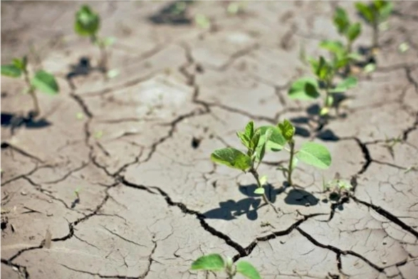
LIMITATIONS:
1. As the farmers are facing many problems in agricultural sector we need to minimize their problems
2.Complexity Factors
3. Low Efficiency

Slide 7
PROPOSED SYSTEM:
Data Collection:
Gather historical crop yield data, weather information, soil quality metrics, and satellite imagery.Utilize IoT devices and sensors for real-time data on temperature, humidity, and other relevant factors.
Training:
Train the model using historical data, optimizing hyperparameters to enhance performance
Integration of Real-time Data:
Implement mechanisms to incorporate real-time weather and sensor data for dynamic updates.

Slide 8
ADVANTAGES:
* Improved Accuracy * Timely Decision-Making * Optimal Resource Allocation * Risk Mitigation * Early Detection of Issues * Accessibility * Customization * Scalability * Sustainability * Research and development

Slide 9
REQUIREMENTS:
Hardware Requirements :
processor: i3
Hard Disk : 1 TB.
Monitor : 14’ Color Monitor.
Mouse : Optical Mouse.
RAM : 4GB.
Software Requirements :
Operating system : Windows 10.
Coding Language : Python.
Front-End : Html,Css,javascript.
Back-End:python

Slide 10
UML DIAGRAMS:
1. USE CASE DIAGRAM
2. CLASS DIAGRAM
3.SEQUENCE DIAGRAM
4. COLLABORATION DIAGRAM
5.ACTIVITY DIAGRAM

Slide 11
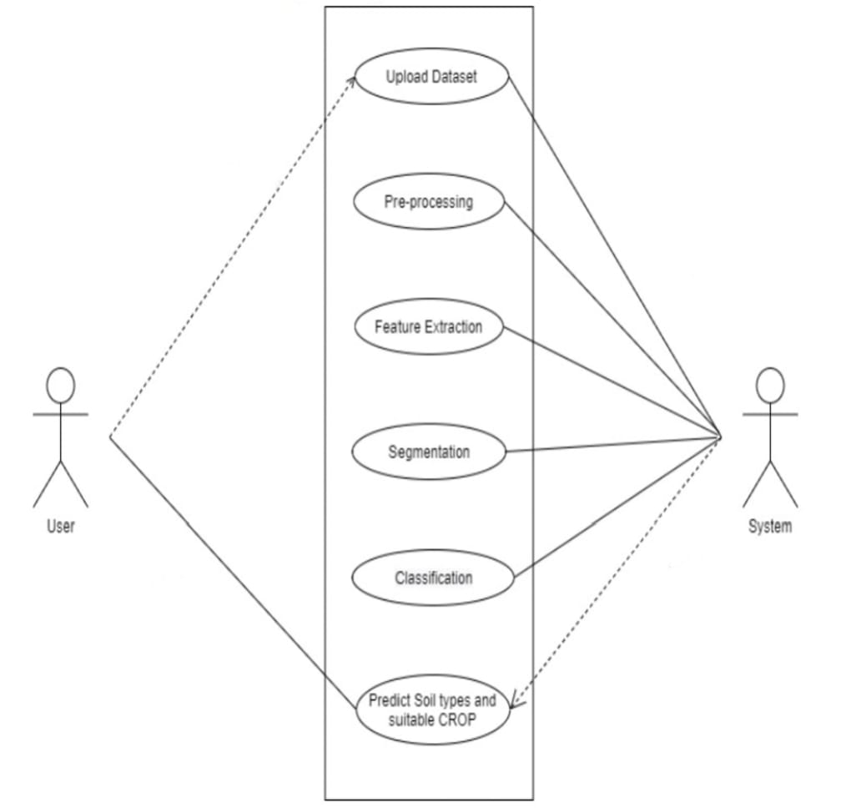
USE CASE DIAGRAM:
A use-case diagram in the Unified Modeling Language (UML) is a type of behavioral diagram defined by and created from a Use-case analysis. Its purpose is to present a graphical overview of the functionality provided by a system in terms of actors, their goals (represented as use cases), and any dependencies between those use cases. The main purpose of a use case diagram is to show what system functions are performed for which actor. Roles of the actors in the system can be depicted.

Slide 12
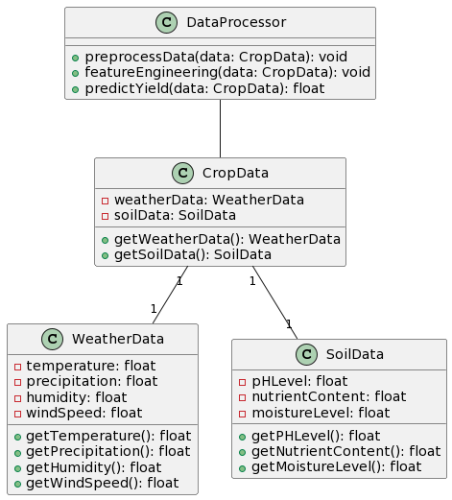
CLASS DIAGRAM:
In software engineering, a class diagram in the Unified Modeling Language (UML) is a type of static structure diagram that describes the structure of a system by showing the system's classes, attributes, operations (or methods), and the relationships among the classes. It explains which class contains information.

Slide 13
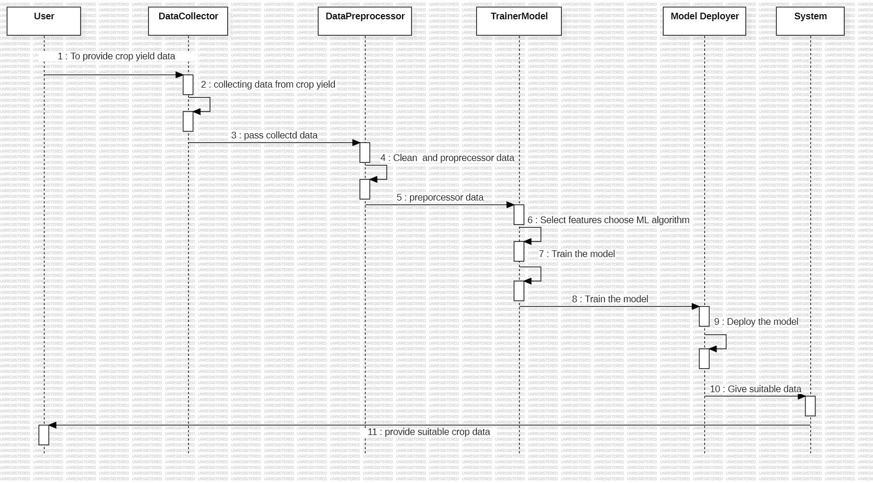
Sequence diagram:

Slide 14
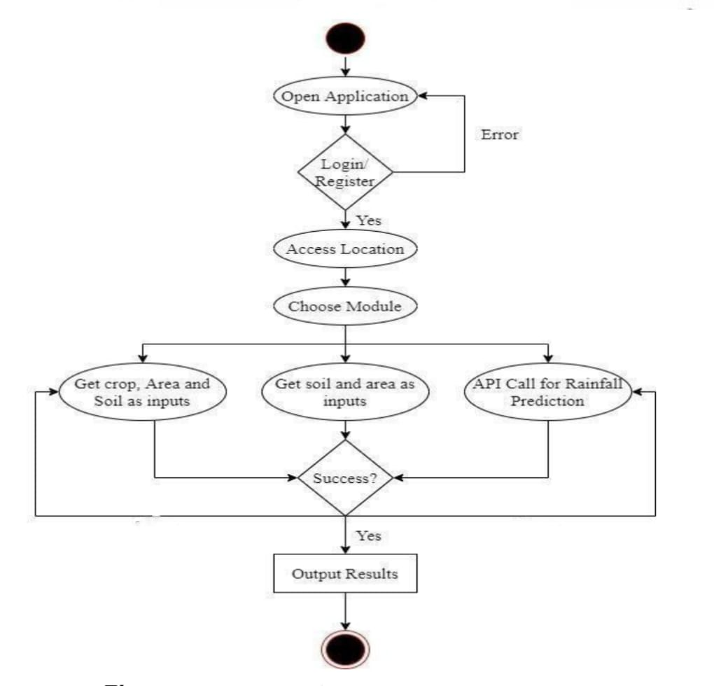
ACTIVITY DIAGRAM:
Activity diagrams are graphical representations of workflows of stepwise activities and actions with support for choice, iteration and concurrency. In the Unified Modeling Language, activity diagrams can be used to describe the business and operational step-by-step workflows of components in a system. An activity diagram shows the overall flow of control.

Slide 15
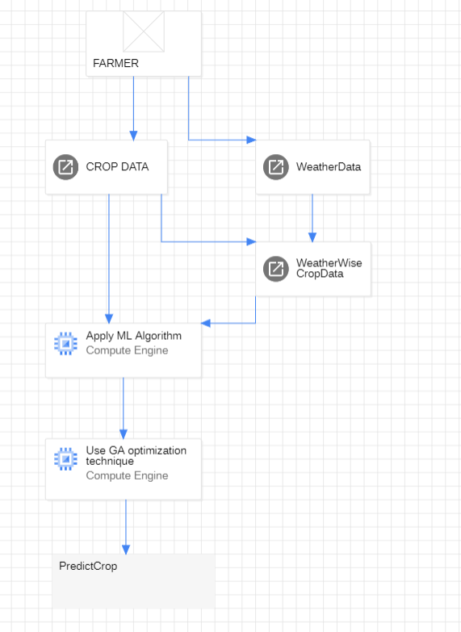

Architecture diagram:
Use GA optimization technique(A genetic algorithm (GA) is a method for solving both constrained and unconstrained optimization problems based on a natural selection process that mimics biological evolution)

Slide 16
REFERENCES:
1.ScienceDirect.com
https://www.google.com/url?sa=t&source=web&rct=j&opi=89978449&url=https://www.sciencedirect.com/science/article/pii/S0168169920302301&ved=2ahUKEwic4MOW0sGEAxUP8TgGHS3EB9QQFnoECCIQAQ&usg=AOvVaw2CW7xWmR9fnjn7nGIMHahe
2.Frontiers
https://www.google.com/url?sa=t&source=web&rct=j&opi=89978449&url=https://www.frontiersin.org/journals/plantscience/articles/10.3389/fpls.2023.1128388/full&ved=2ahUKEwic4MOW0sGEAxUP8TgGHS3EB9QQFnoECCgQAQ&usg=AOvVaw2PritZbvWa8MaljuNd1CGe

Slide 17
CONCLUSION:
In summary, the Crop Yield Prediction System we've proposed combines advanced technology with user-friendly design to help farmers make better decisions. By gathering and analyzing data on factors like weather and soil quality, the system predicts crop yields accurately. The easy-to-use interface allows users to input data and receive predictions, promoting informed decision-making in agriculture. With security measures in place and continuous updates, this system aims to enhance productivity and sustainability in farming practices.

Slide 18


